Slide 1


Nature and Characteristics of an
Academic Text

Slide 2




Prepare these
before we start class:
You can have you phones, notebooks or papers and pens with you if you want to write-down notes. You may also ask permission if you want to input additional ideas or experiences in relation with our presentation.

Slide 3


Academic Text
is a written language that provides information, which contain ideas and concepts that are related to the particular discipline

Slide 4

STRUCTURE
TONE
LANGUAGE
CITATION
COMPLEXITY
EVIDENTS-BASED ARGUMENTS
THESIS DRIVEN

Slide 5



STRUCTURE
The basic structure that is used by an academic text is consist of three (3) parts introduction, body, and conclusion which is formal and logical. This kind of structure enables the reader to follow the argument and navigate the text. In academic writing a clear structure and a logical flow are imperative to a cohesive text.

Slide 6
TONE
This refers to the attitude conveyed in a piece of writing. The arguments of others are fairly presented and with an appropriate narrative tone. When presenting a position or argument that disagrees with one’s perspectives, describe the argument accurately without loaded or biased language.

Slide 7
LANGUAGE
It is important to use unambiguous language. Clear topic sentences enable a reader to follow your line of thinking without difficulty. Formal language and the third person pointof-view should be used. Technical language appropriate to area of study may also be used, however, it does not mean using “big words” just for the sake of doing so.

Slide 8
CITATION
Citing sources in the body of the paper and providing a list of references as either footnotes or endnotes is a very important aspect of an academic text. It is essential to always acknowledge the source of any ideas, research findings, data, or quoted text that have been used in a paper as a defense against allegations of plagiarism.

Slide 9
COMPLEXITY
An academic text addresses complex issues that require higher-order thinking skills to comprehend.

Slide 10
EVIDENCE-BASED ARGUMENTS
What is valued in an academic text is that opinions are based on a sound understanding of the pertinent body of knowledge and academic debates that exist within, and often external to a specific discipline.

Slide 11
THESIS-DRIVEN
The starting point of an academic text is a particular perspective, idea or position applied to the chosen research problem, such as establishing, proving, or disproving solutions to the questions posed for the topic.

Slide 12


FEATURES OF AN ACADEMIC TEXT

Slide 13
Complex - Written language has no longer words, it is lexically more varied vocabulary.
Written texts are shorter and the language has more grammatical complexity, including more subordinate clauses and more passives.
2. Formal - Should avoid colloquial words and expressions.
3. Precise - Facts are given accurately and precisely.

Slide 14
4. Objective - has fewer words that emphasize on the information you want to give and the arguments you want to make - mostly use nouns (adjectives), rather than verbs (adverbs)
5. Explicit - It is the responsibility of the writer in English to make it clear to the reader how the various parts of the text are related.
Accurate - Uses vocabulary accurately - Most subjects have words with narrow specific meanings.

Slide 15
7. Hedging - It is necessary to make decisions about your stance on a particular subject, or the strength of the claims you are making.
8. Responsible - You must be responsible for and must be able to provide evidence and justification for any claims you make.
Organize - Well-organized. - It flows easily from one section to the next in a logical fashion.
Plan - Well-planned.
- It usually takes place after research and evaluation, according to specific purpose and plan.

Slide 16


PURPOSES IN READING AN ACADEMIC TEXT
Notes:
Subject specific vocabulary

Slide 17
1. To locate a main idea;
2. To scan for information;
3. To identify gaps in existing studies;
4. To connect new ideas to existing ones;
5. To gain more pieces of information;
6. To support a particular writing assignment; and,
7. To deeply understand an existing idea.

Slide 18
Factors to Consider in Writing Academic Text
1. State critical questions and issues;
2. Provide facts and evidence from credible sources;
3. Use precise and accurate words while avoiding jargon;
4. Take an objective point of view;
5. List references; and,
6. Use cautious language

Slide 19
ACADEMIC LANGUAGE
Academic language is the language needed by students to do the work in schools. It includes, for example, discipline-specific vocabulary, grammar and punctuation, and applications of rhetorical conventions and devices that are typical for a content area (e.g., essays, lab reports, discussions of a controversial issue.) Students who master academic language are more likely to be successful in academic and professional settings.
Notes:
Subject specific vocabulary

Slide 20
Social language is the set of vocabulary that allows us to communicate with others in the context of regular daily conversations.
Notes:
Subject specific vocabulary

Slide 21
Characteristics of Academic Language
A. Formal - It should not sound conversational or casual. Colloquial, idiomatic, slang or journalistic expressions should particularly be avoided. Examples: Use… Instead… Consider, monitor Look at Revise, review Go over Solve, repair, amend Fix
B. Objective - This means it is unbiased. It should be based on facts and evidence and are not influenced by personal feelings.
C. Impersonal - This involves avoiding the personal pronouns ‘I’ and ‘we’. For example, instead of writing ‘I will show’, you might write ‘this report will show’. The second person, ‘you’, is also to be avoided.

Slide 22
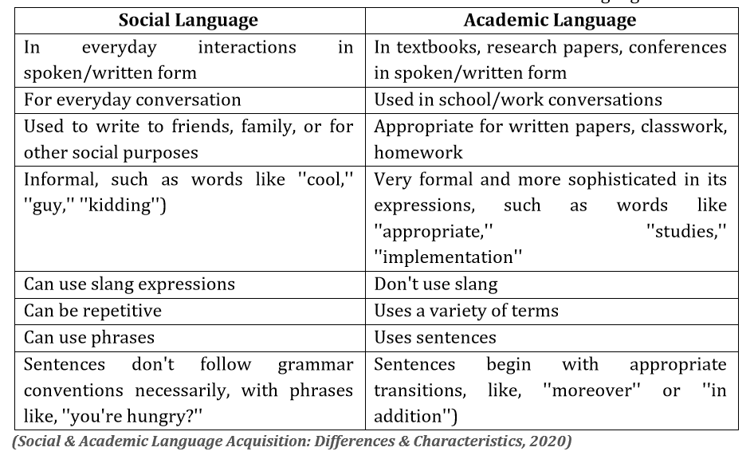

Slide 23
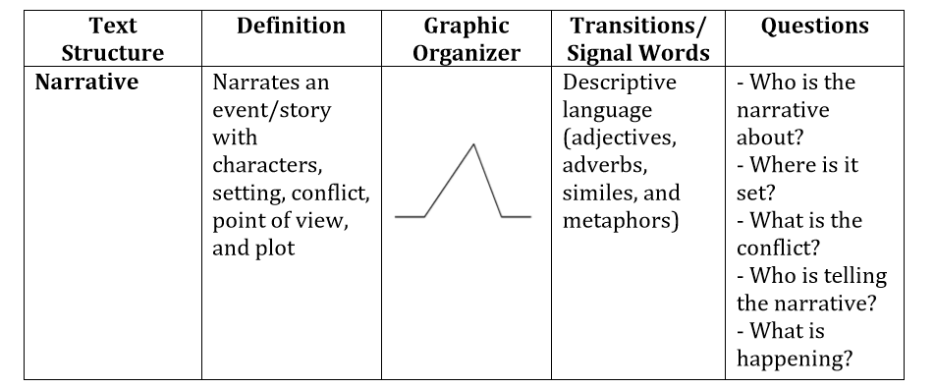

Slide 24
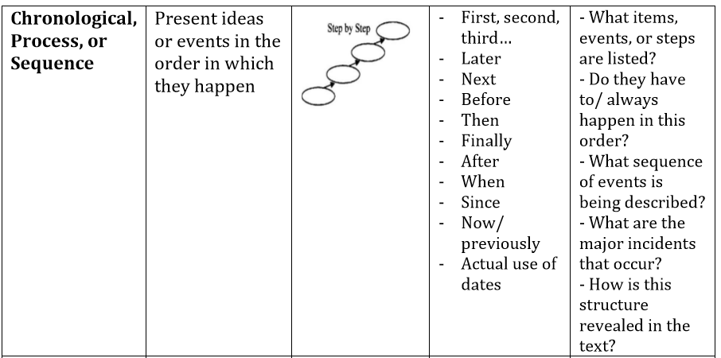

Slide 25
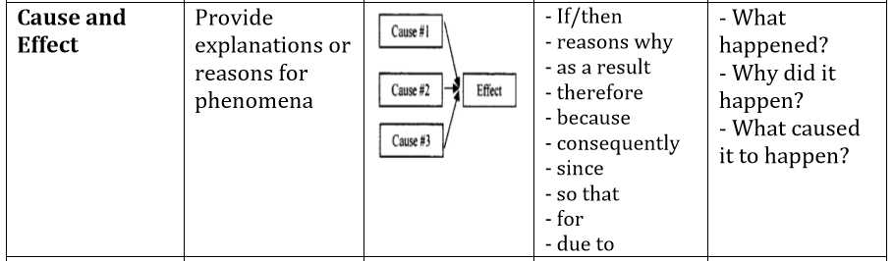

Slide 26
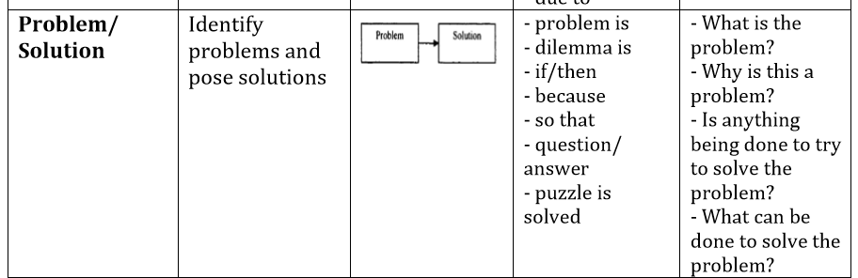

Slide 27
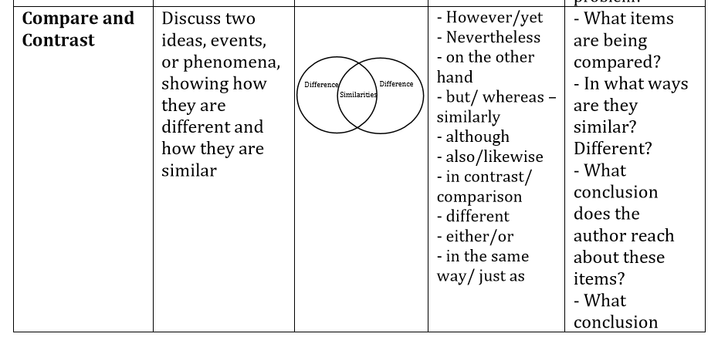

Slide 28
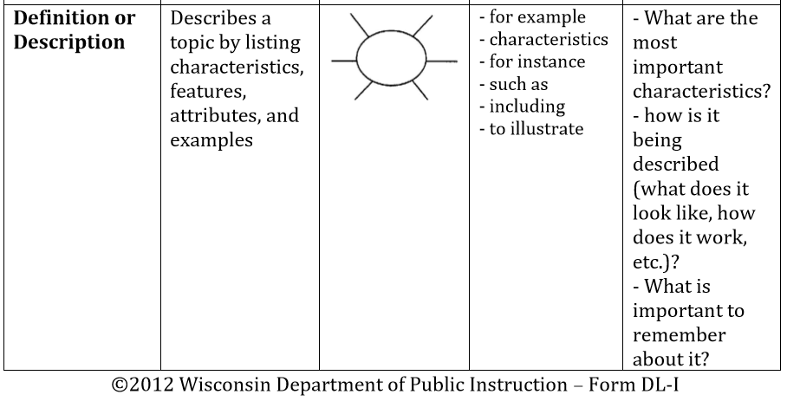

Slide 29
5 W's, 1 H.
This technique relies on six crucial questions: who, what, when where, why, and how. These questions make it easy to identify the main character, important details, and main idea.

Slide 30
4. First Then Finally.
This technique helps students summarize events in chronological order.

Slide 31
Techniques in Summarizing Academic Texts
Basic Rules: A. Erase things that don’t matter. Delete trivial material that is unnecessary to understanding.
B. Erase things that repeat. Delete redundant material. In note taking, time and space is precious. If a word or phrase says basically the same thing you have already written down, then don’t write it again!

Slide 32
C. Trade, general terms for specific names. Substitute superordinate terms for lists (e.g., flowers for daisies, tulips for roses). Focus on the big picture. Long, technical lists are hard to remember. If one word will give you the meaning, then less is more.
D. Use your own words to write the summary. Write the summary using your own words but make sure to retain the main points.

Slide 33
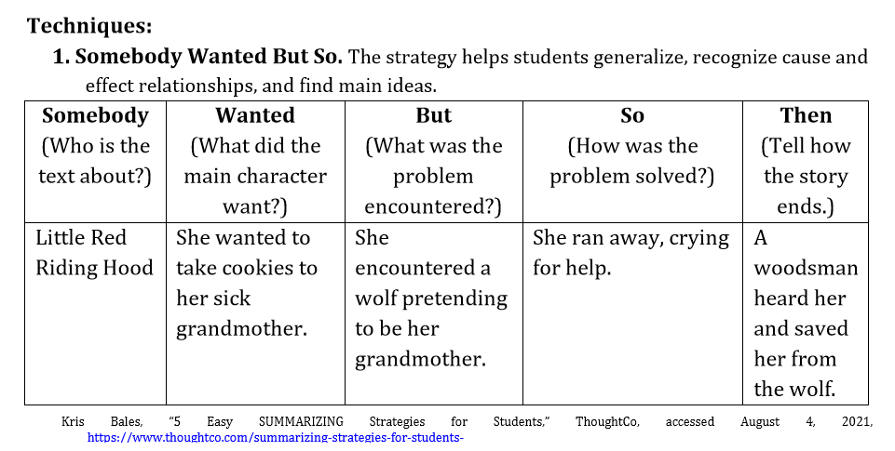

Slide 34
